Slide 1
RPT 6 Spring SMART Goal DiscussionVisit
May 2021

Slide 2
Agenda
Key messages
2019-20 SMART Goals
Interim report review
OCAS Update
Discussion

Slide 3
1. Key Messages: Our collective focus
Please continue to focus on students and their programming – particularly students intending to graduate this year
Please continue to involve all partners in decision-making and use the most up-to-date announcements from your boards and colleges, and health unit.
If you have questions, or want to discuss RPT-specific concerns, please get in touch.

Slide 4
2. 2020-21 SMART Goals
1. Develop “learning-to-learn on-line” modules to make available to our dual credit students as they navigate virtual learning. | Board and college reps to highlight needed modules

Slide 5
2. 2020-21 SMART Goals
Collaborate to develop and deliver virtual activities for 100% of approved grades 7-8 activity days | Committee in January to look at resources and third party supports or outside agencies The following RPT members have volunteered to work on this: Sue/Durham College Edina/Loyalist College Jennifer/DDSB Jonathan/Fleming College Alex/PVNCCDSB View the SCWI On-Line Activity Webinar to see what is happening around the province

Slide 6
2. 2020-21 SMART Goals
To determine best practices, gather feedback from our dual credit students, high school teachers and college faculty regarding on-line vs. face-to-face vs. hybrid models of dual credit delivery. | Strike a committee to look at its’ development. The following RPT members have volunteered: Kelly/TLDSB Stephen/DCDSB • Look at TLD and Fleming’s feedback surveys as a base to quickly develop a unique survey

Slide 7
3. Interim Report Review

Slide 8
Interim Report Review: Student Data
Proposal # | Proposal Name | TOTAL Number of Students who were disengaged and/or underachieving | TOTAL Number of Students also involved in a SHSM | TOTAL Number of Students involved in an OYAP program | Total Number of Students Who Started the Dual Credit Program by Age | Total in 3 Target Groups | % in one or more target groups
06.03P | Loyalist Links for the Primary Target Group | 22 | 20 | 9 | 75 | 51 | 68%
06.13P | Fleming Health and Wellness for the Primary Target Group | 26 | 16 | 1 | 71 | 43 | 61%

Slide 9
2020-21 Interim Report Data
Measure | RPT Semester 1 Data | Provincial Semester 1 Data
Number of students who started | 1,228 | 5,888
Retention | 94% | 85%
Success | 95% | 92%
Preliminary 2020-21 data as reported by RPTs in EDCS.

Slide 10
Resources
Interim Reporting Webinar
http://www.scwi.ca/scwi/edcs.php
http://scwi.ca/scwi/edcs.php

Slide 11
Dual Credit Analysis
Application Cycles 2017 - 2020

Slide 12
Key Findings
KEY FINDINGS:
Dual credit students are receiving offers in greater proportion than all applicants.
Of the applicants who receive offers, a larger proportion of dual credit students are enrolling (77%) as compared to applicants system wide (71%).
Dual credit students who used a voucher continue to be less likely to enrol than their other dual credit counterparts. They are also less like to be retained for the entirety of their program.
96% of all dual credit applicants received an offer to an Ontario college
77% of all dual credit applicants who received an offer subsequently enroled at college.
94% of dual credit applicants who apply with a voucher received an offer to an Ontario college
59% of all dual credit applicants who applied with a voucher subsequently enroled at college.
System wide
86% of all applicants received an offer to an Ontario college.
71% of all applicants who received an offer subsequently enroled at college.

Slide 13
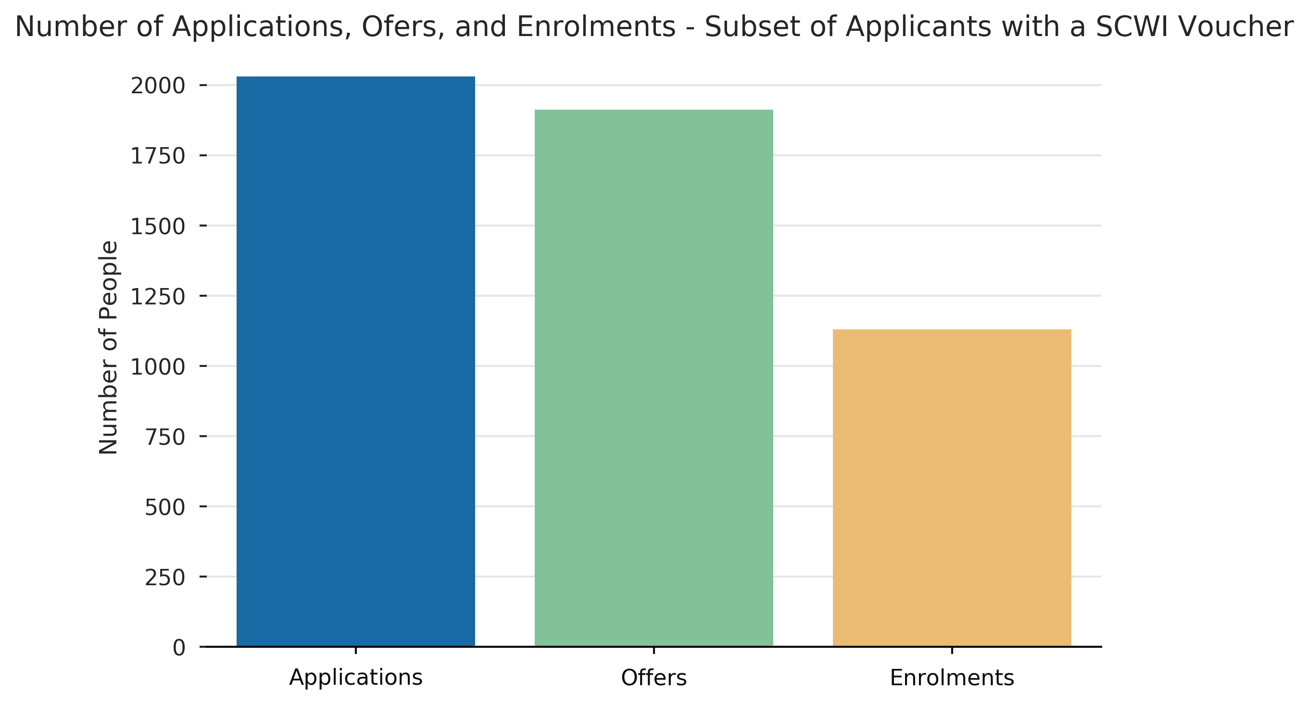
Applications, Offers, Enrolments – Dual Credit vs. Dual Credits with an SCWI Voucher

Slide 14
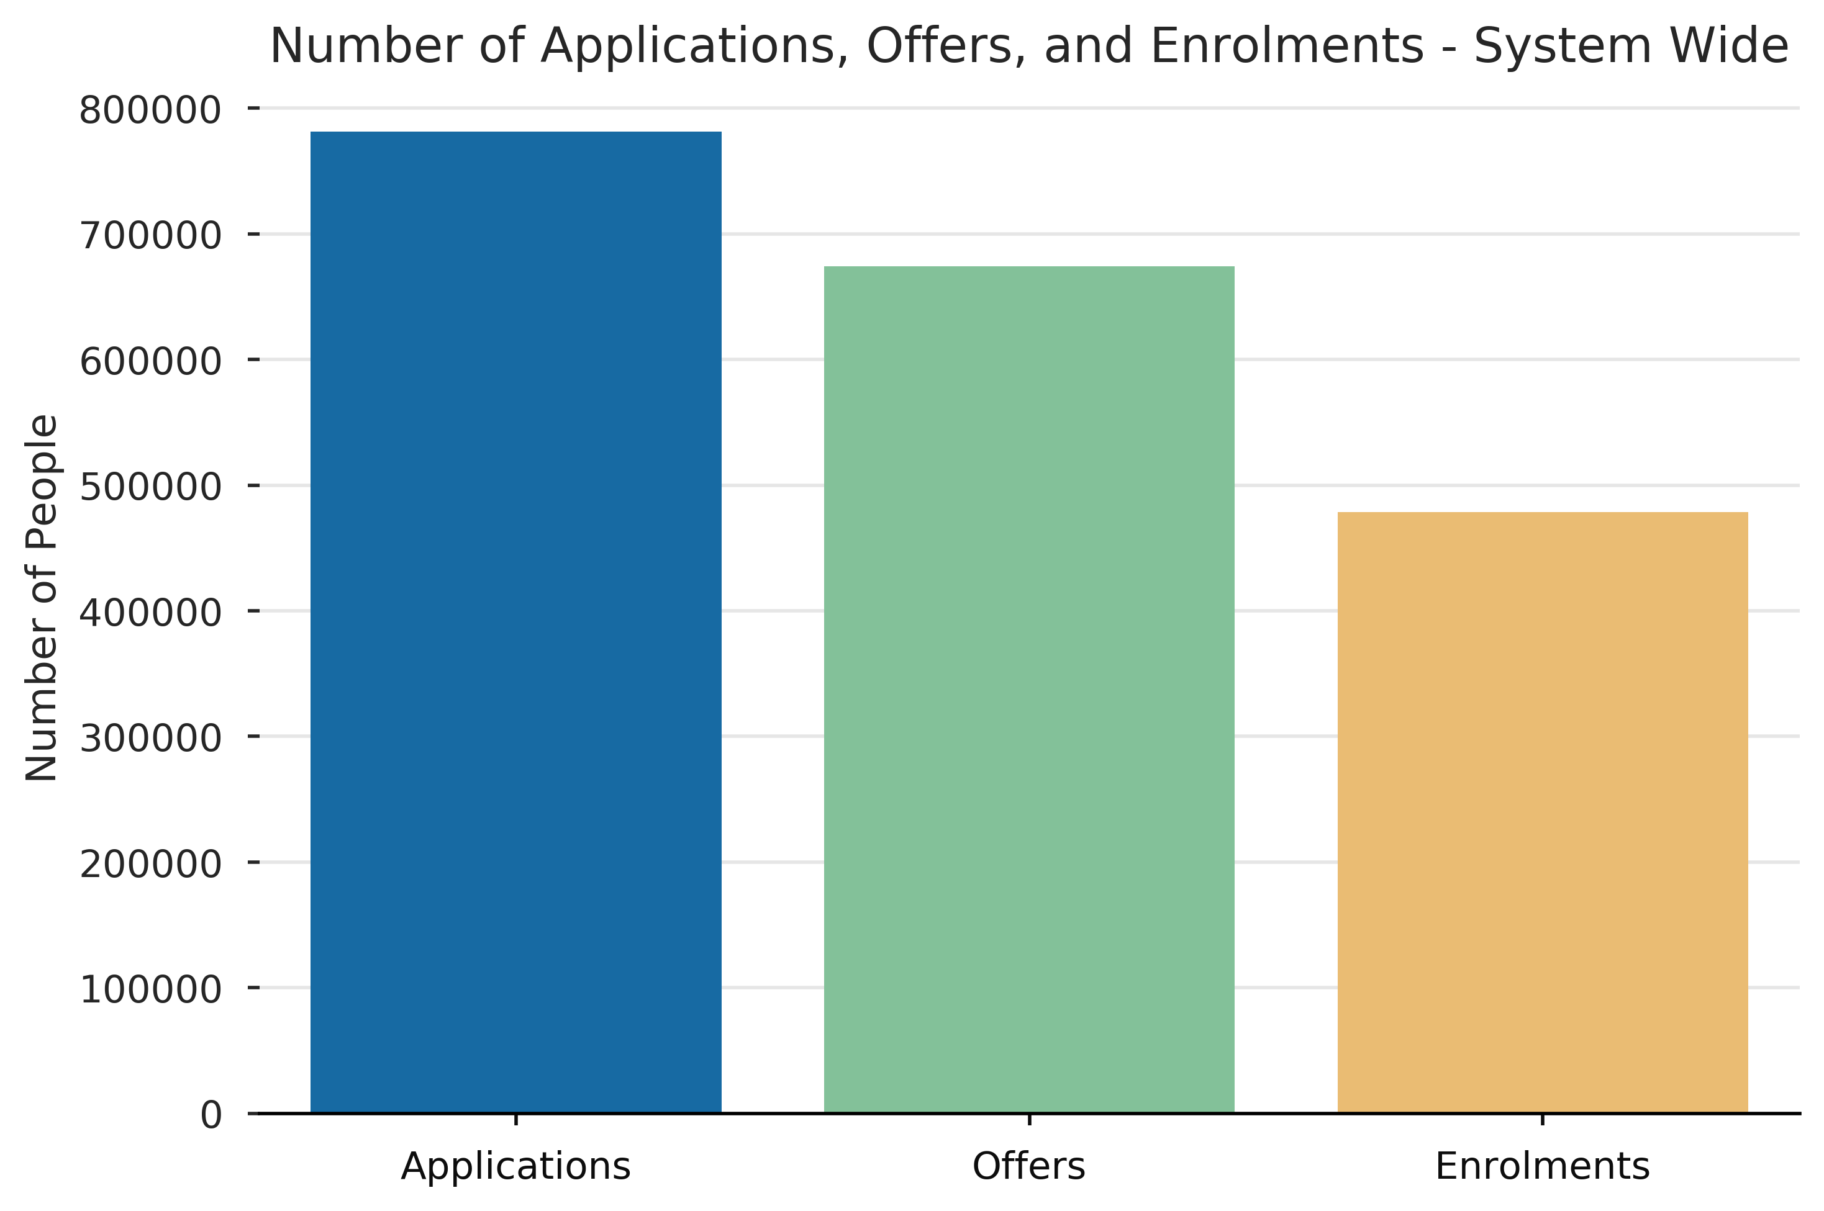
Applications, Offers, Enrolments – Dual Credit vs. System Wide

Slide 15
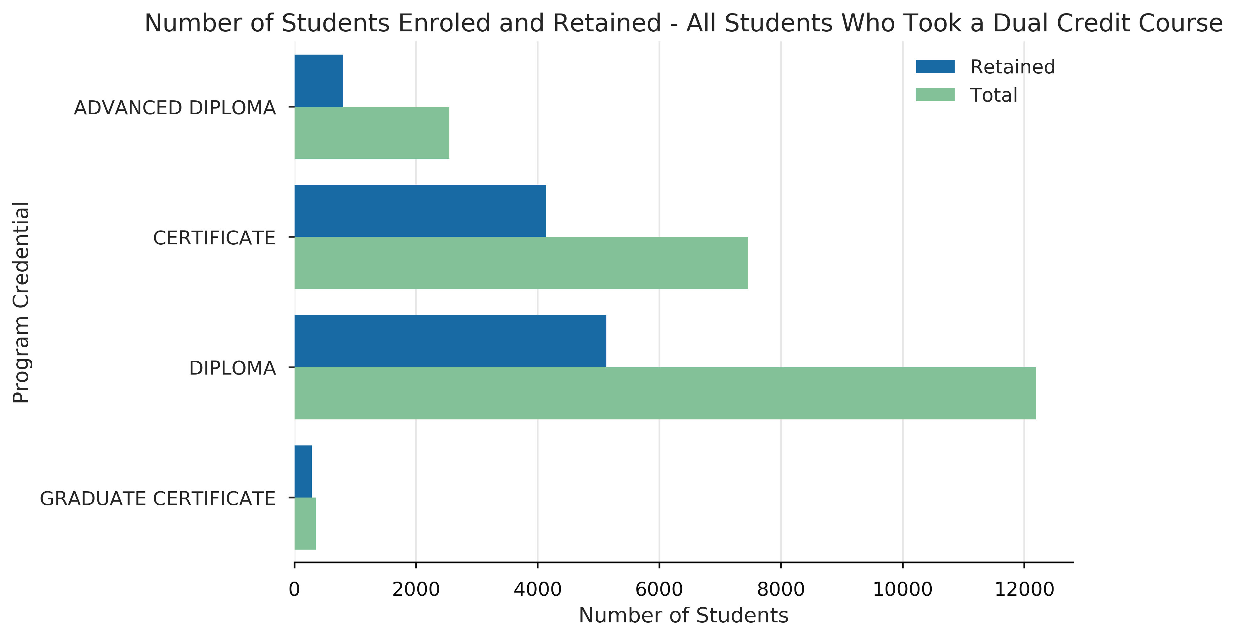
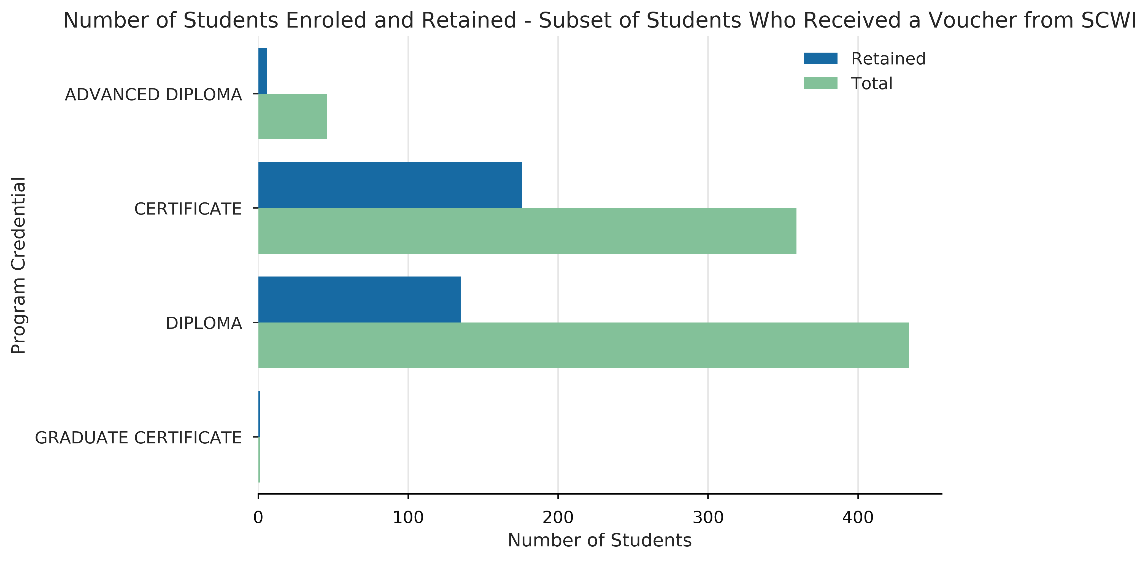
Retention by Credential Type – Dual Credit vs. Dual Credit with a SCWI voucher

Slide 16
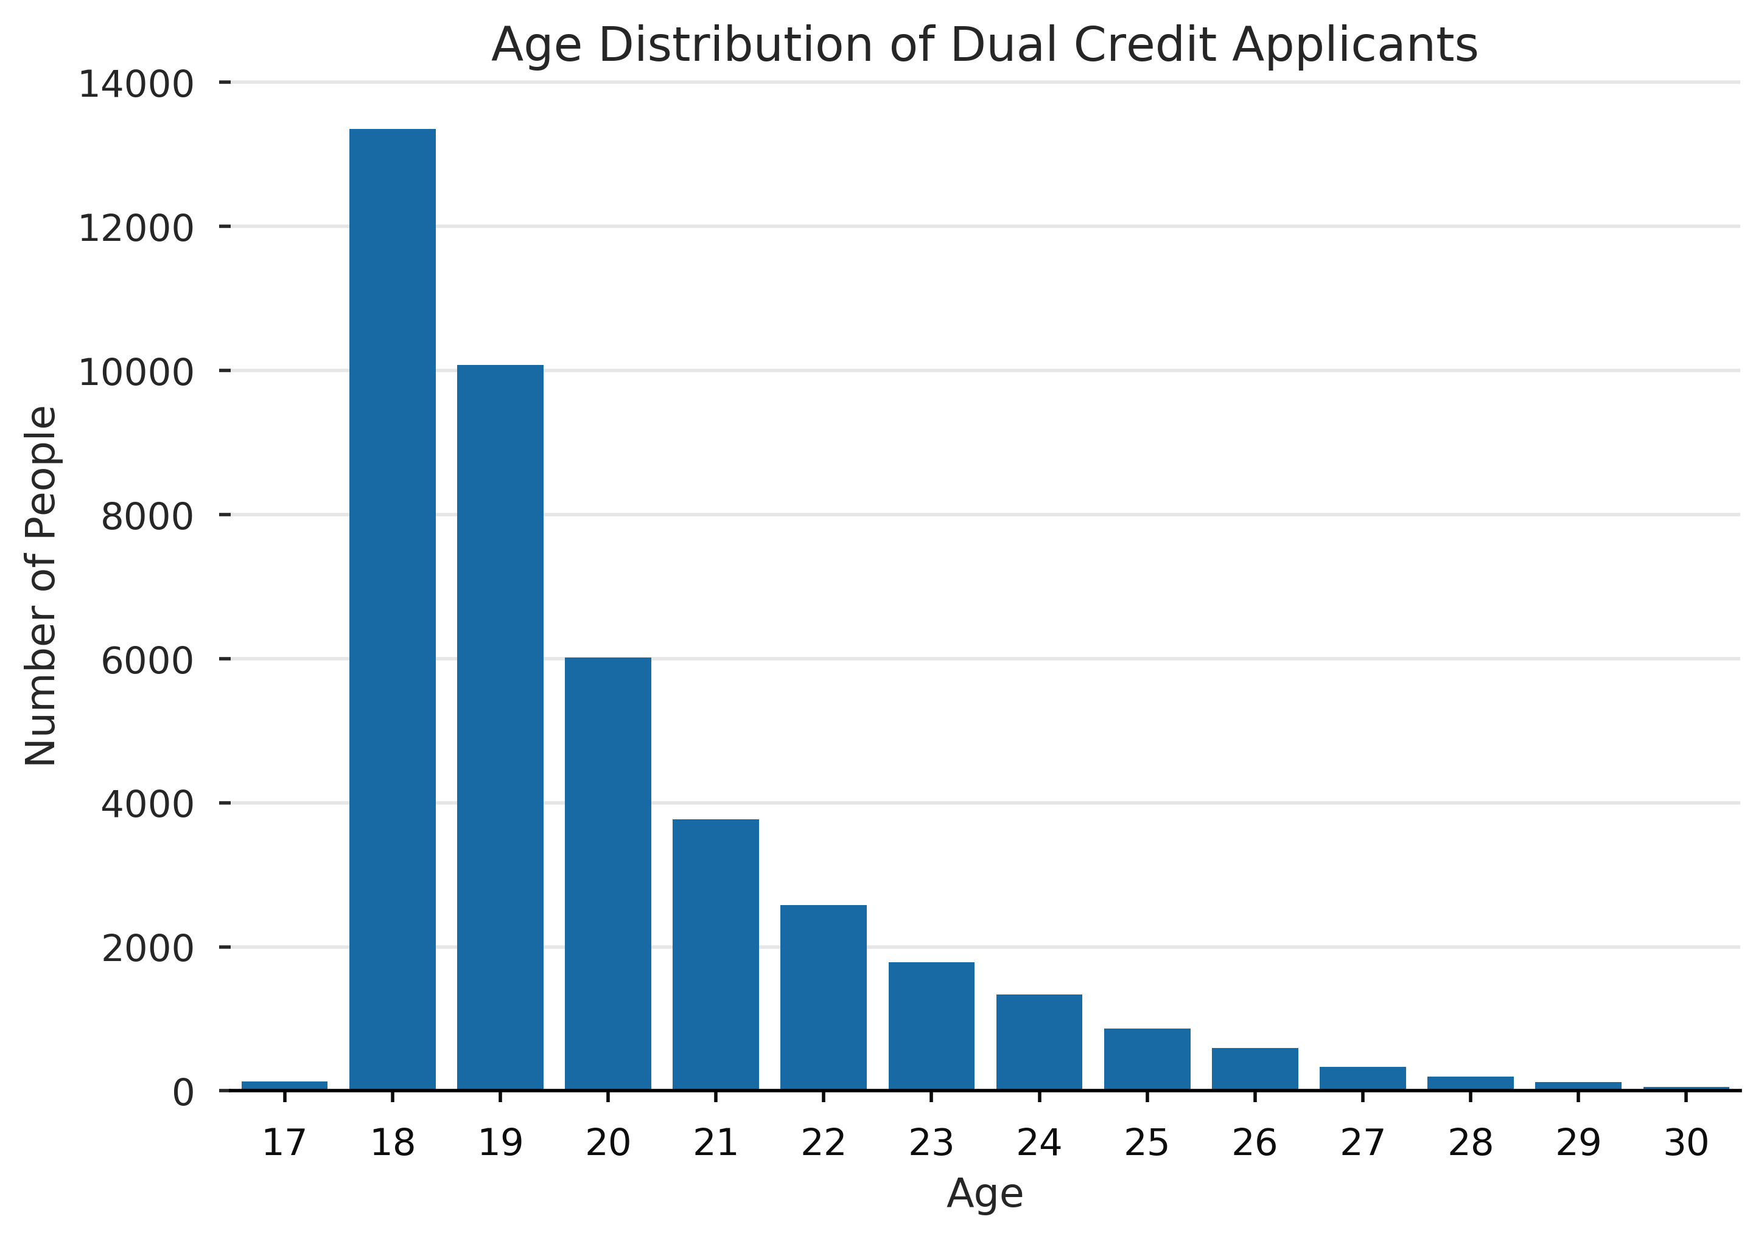
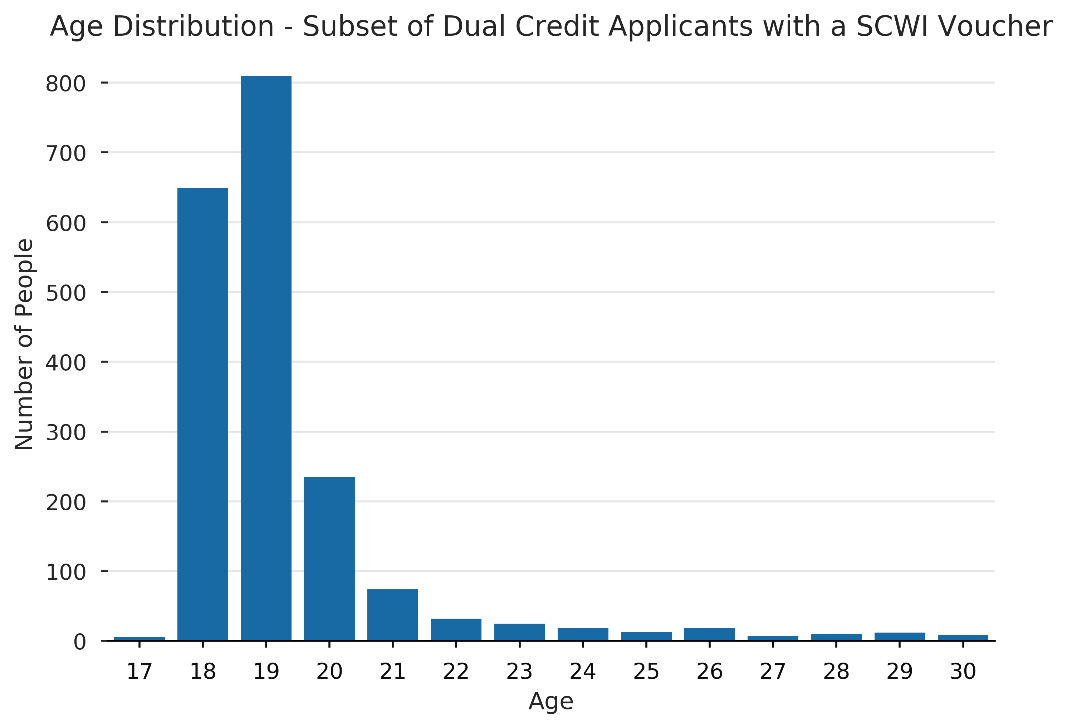
Age Breakdown

Slide 17
Other Research Questions?
Is there research that you are doing related to dual credit students?
What other areas should we be exploring with OCAS?
http://scwi.ca/scwi/research.php
http://iject.ca/iject/research.php

Slide 18
4. Discussion
Questions
Feedback
Comments

Slide 19
Contact Us
David Armstrong davidarmstrong@ontariodirectors.ca
Janine Griffore janine.griffore@gmail.com
Phil Hedges PhilHedges@kwic.com
Sonja Vandermeer svandermeer@ontariodirectors.ca

