Slide 1
Semester One Dual Credit Student Survey
For the 2024-2025 School Year
Student Responses: 721 (472 completed in semester two of the 2023-2024 school year)

Slide 2
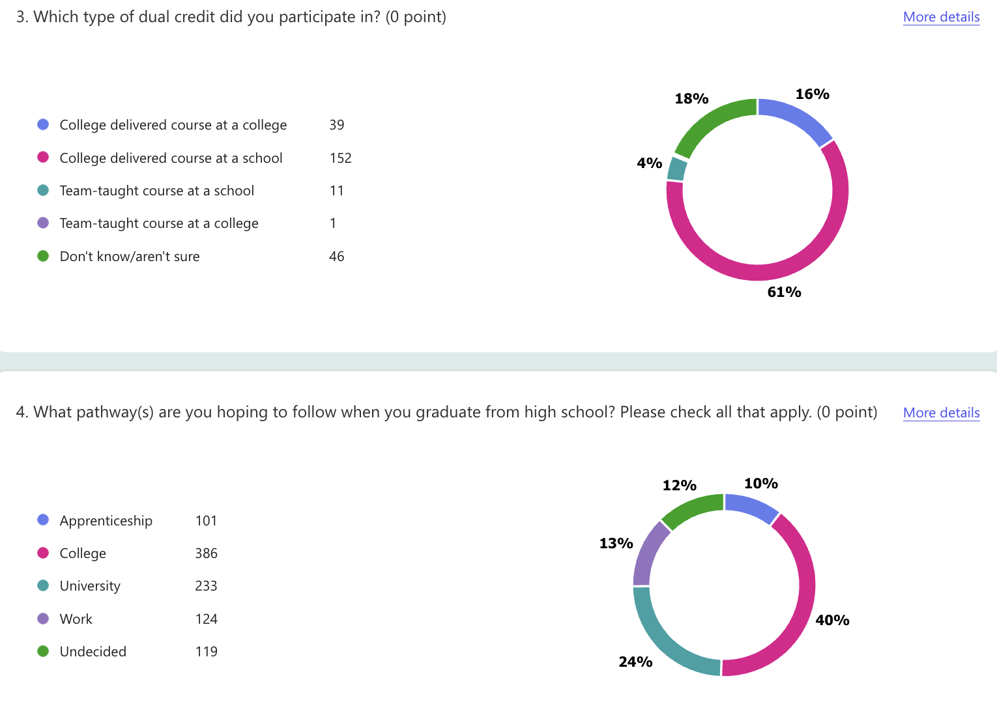

Slide 3
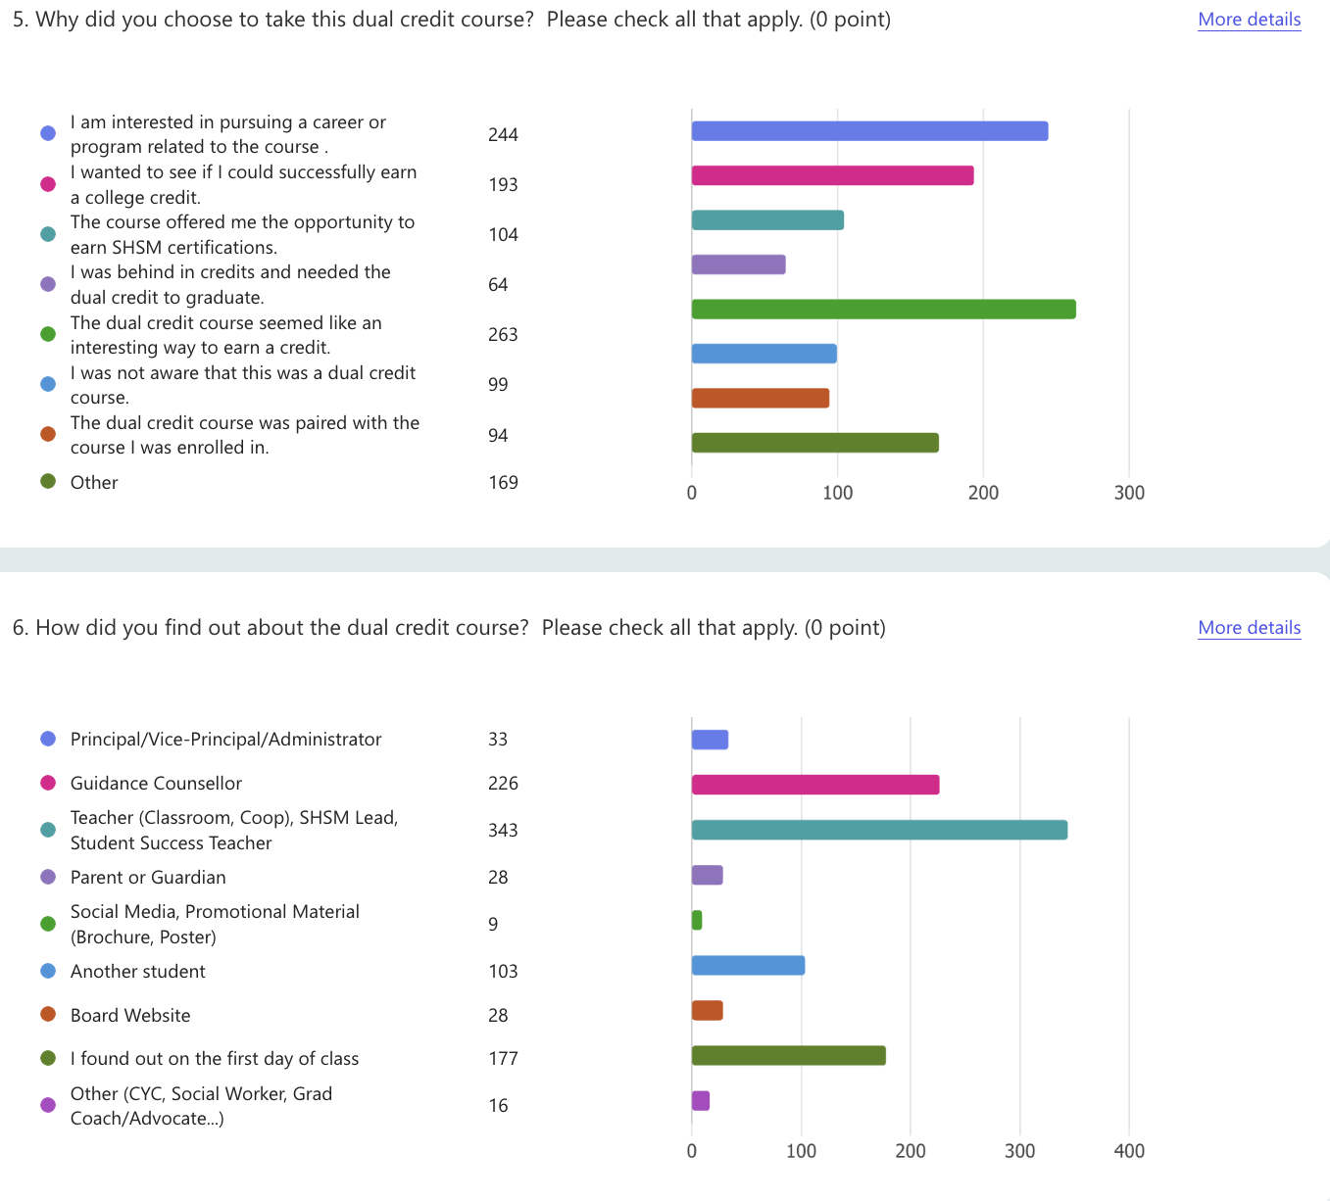

Slide 4
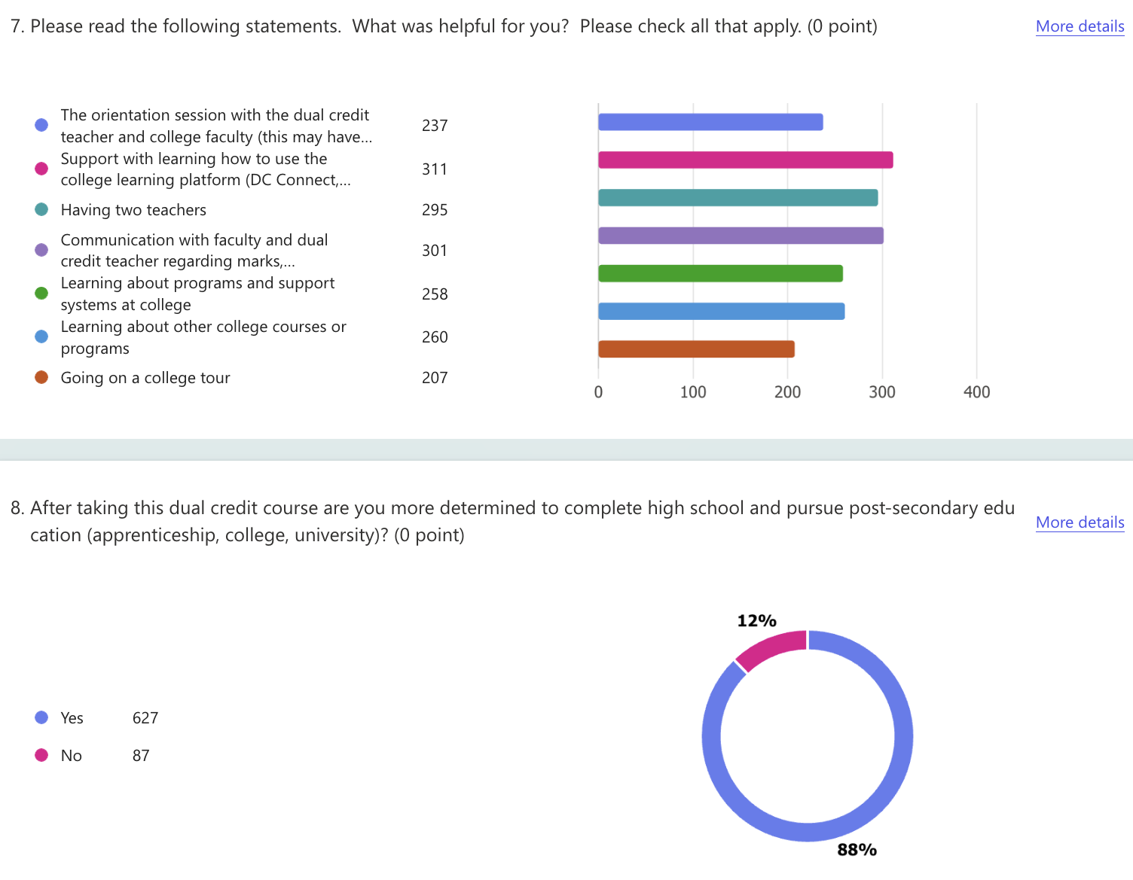

Slide 5
